Slide 1
Remote Procedure Call

Slide 2
Remote Procedure Call
Remote Procedure Call (RPC) is similar to RMI
Client program calls a procedure that runs in another program running in a server process
Servers may be clients of other servers to allow chain of RPC’s
Server Process defines Service Interface(contains the list of procedures
RPC chooses at least once or at most once invocation semantics.
RPC is implemented over Request-Reply Protocol

Slide 3
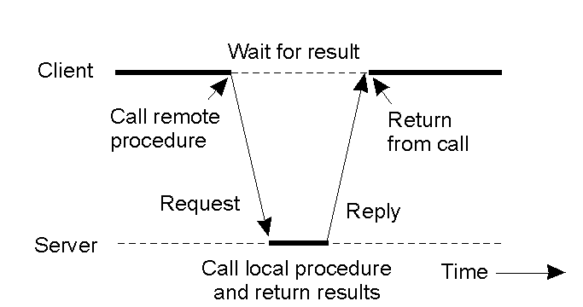
Client and Server Stubs
Principle of RPC between a client and server program.

Slide 4
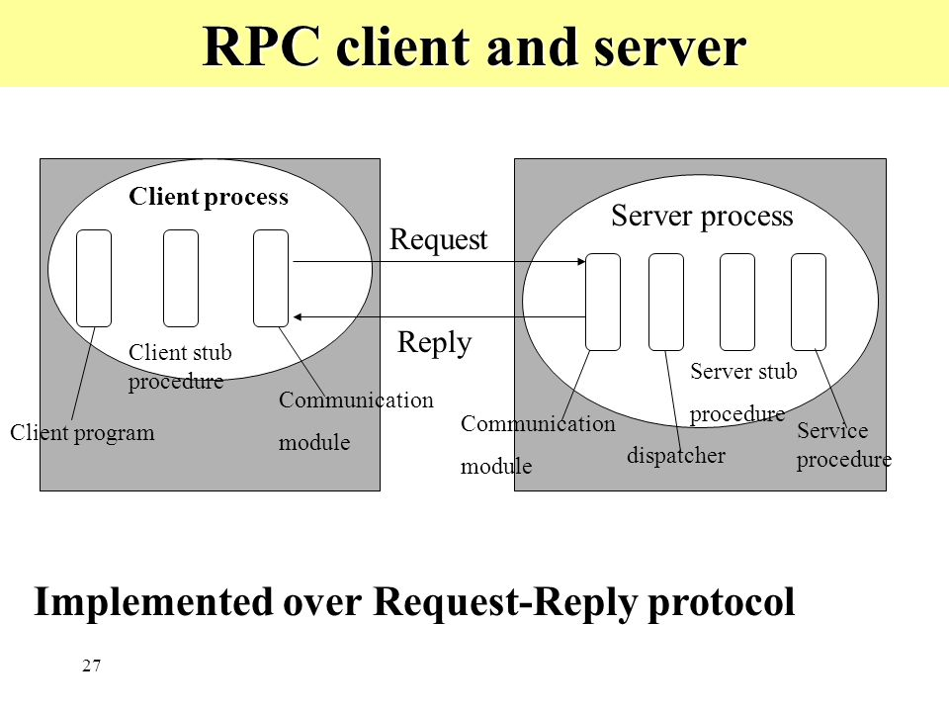

Slide 5
Steps of a Remote Procedure Call
Always there is one client stub procedure for each procedure in the service interface
Client stub behaves like a local procedure to the client
But instead of executing the call, client stub marshals the procedure ID & arguments into a Request message.
Request message is sent to sever via communication module

Slide 6
Steps of a Remote Procedure Call
5. Server contains dispatcher together with one server stub & one service procedure for each procedure in the service interface.
6. Dispatcher uses procedure ID to select one of the server stub procedures
Server stub unmarshals the arguments of the Request message
Server executes the corresponding Service procedure
Server stub Marshals the return values into Reply message & send it to client
Client stub receives the Reply message & unmarshals the results

Slide 7
RPC in Practice - DCE RPC
The Distributed Computing Environment (DCE) RPC is developed by the Open Software Foundation (OSF)/Open Group.
DCE is a middleware executing as an abstraction layer between (network) operating systems and distributed applications.
Microsoft derived its version of RPC from DCE RPC (e.g., MIDL compiler, etc.)
DCE includes a number of services:
  Distributed file service
  Directory service
  Security service
  Distributed time service

